Slide 1

Development of Islamic Finance in Uzbekistan
Zaib-un-Nisa
Representative AlHuda CIBE FZ LLE
Tashkent - Uzbekistan

Slide 2

Global Overview of Islamic Finance
Islamic finance has evolved in the aftermath of financial crisis to provide alternative means of financial intermediation
According to World Competitiveness Reports & Researchers
  Islamic Finance grew at an annual rate of 17% between 2009 to 2017
  Total Islamic Finance Assets- US$ 2.4 Trillion
  Expected to grow at an average of 19% a year to 2023
  Notable Investment in Islamic FinTech 2015-2018 is US$ 12.6 Mn
Islamic Finance now becoming Emerging not only in Muslim Countries rather non-Muslim Countries as financial system not as religious tool

Slide 3
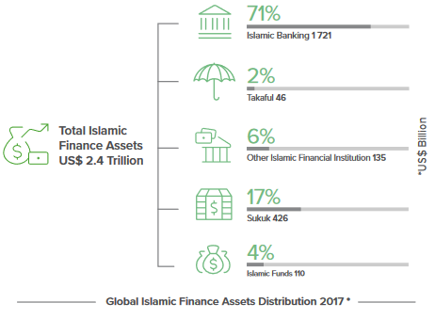
Islamic Finance Products Distribution

Slide 4
Financial Market of Uzbekistan
Banks - 29 Banks in Uzbekistan
Leasing Companies - 133 Lessors in Leasing market
Insurance Companies - 30 Insurance companies in Uzbekistan
Microfinance Companies – 51
Others

Slide 5
Why Islamic Banking & Finance in Uzbekistan?
Emerging trend in Central Asia and worldwide
93.3% of Muslim Population in Uzbekistan. Islamic Finance can be an Increment in Financial Inclusion by attracting capital of population
Increase GPD Growth and improve the Investment Climate by attracting Foreign Direct Investment in Uzbekistan
More stable than of its counter part- conventional banking
Transparent Financial System
Alternative financing products
Promotional of Financial Justice

Slide 6





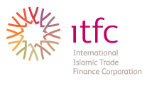

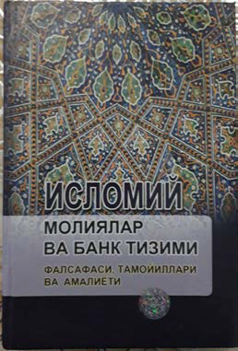




Current Development of Islamic Finance in Uzbekistan
Books published in Uzbek language
Companies providing Islamic financial services
Companies providing Investment as per Sharia rules
Educational Institutes start providing Islamic Finance study

Slide 7
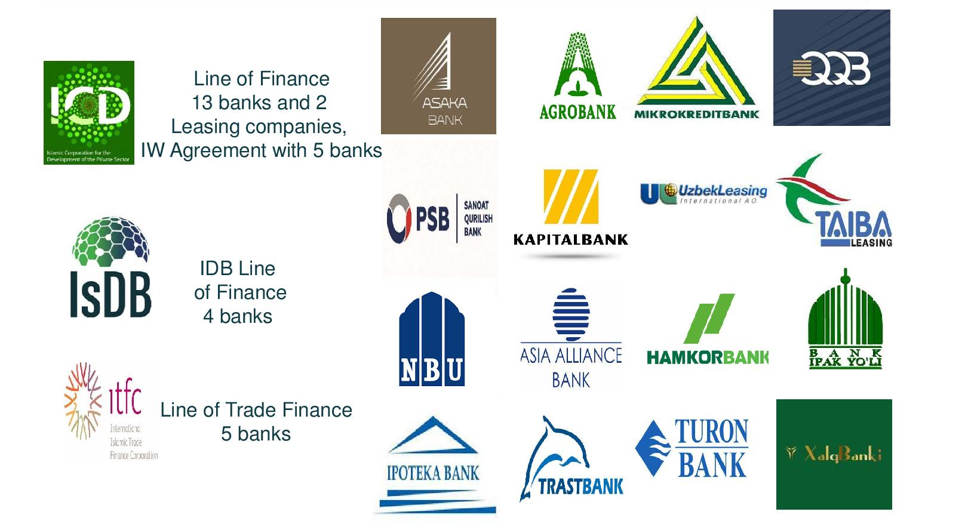
Current Development of Islamic Finance in Uzbekistan

Slide 8
How to start Islamic Finance in Uzbekistan Financial Market
Stand alone/full fledge only Qatar
Subsidiary Malaysia, Indonesia
Window UAE, Singapore, Saudi Arabia
Banks - 29 Banks in Uzbekistan
133 Lessors in Leasing market
Ijarah
30 Insurance companies in Uzbekistan
Takaful
Microfinance Companies – 51
Islamic Micro financing , Qard
Capital Market
Sukuk (Islamic Bond)

Slide 9
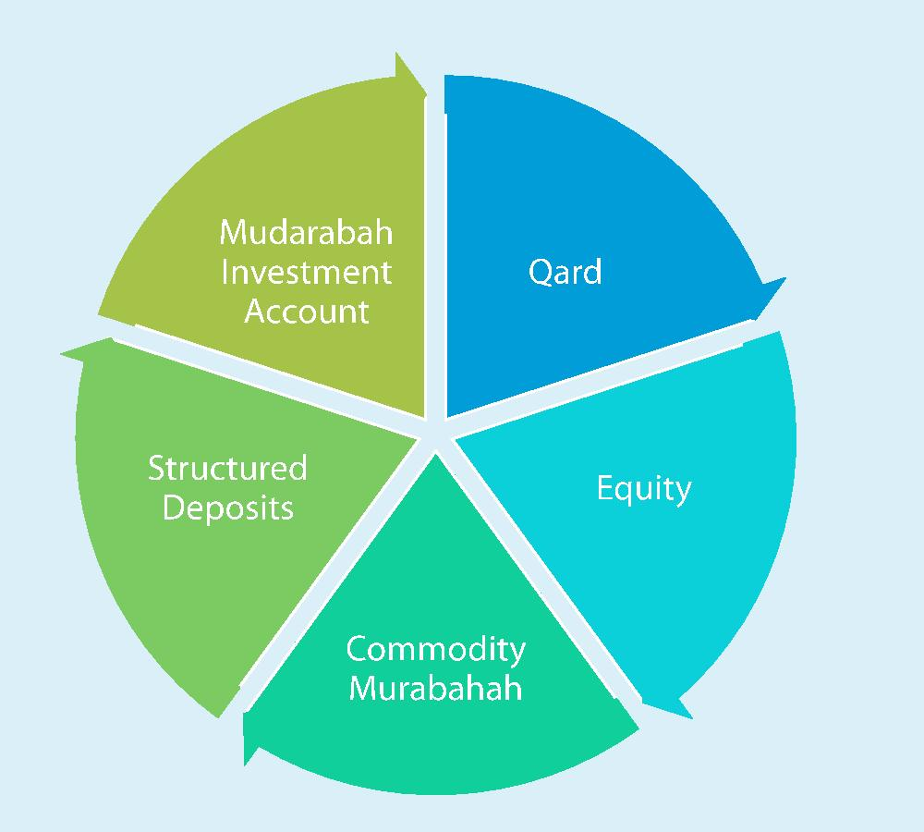
Sources of Funds

Slide 10
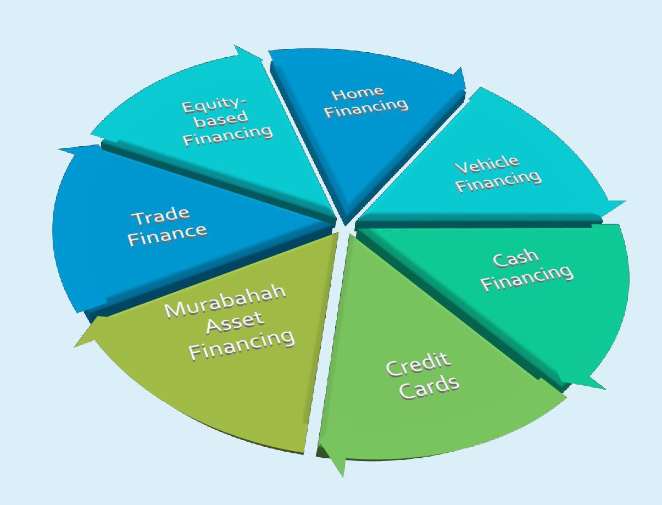
Uses of Funds

Slide 11
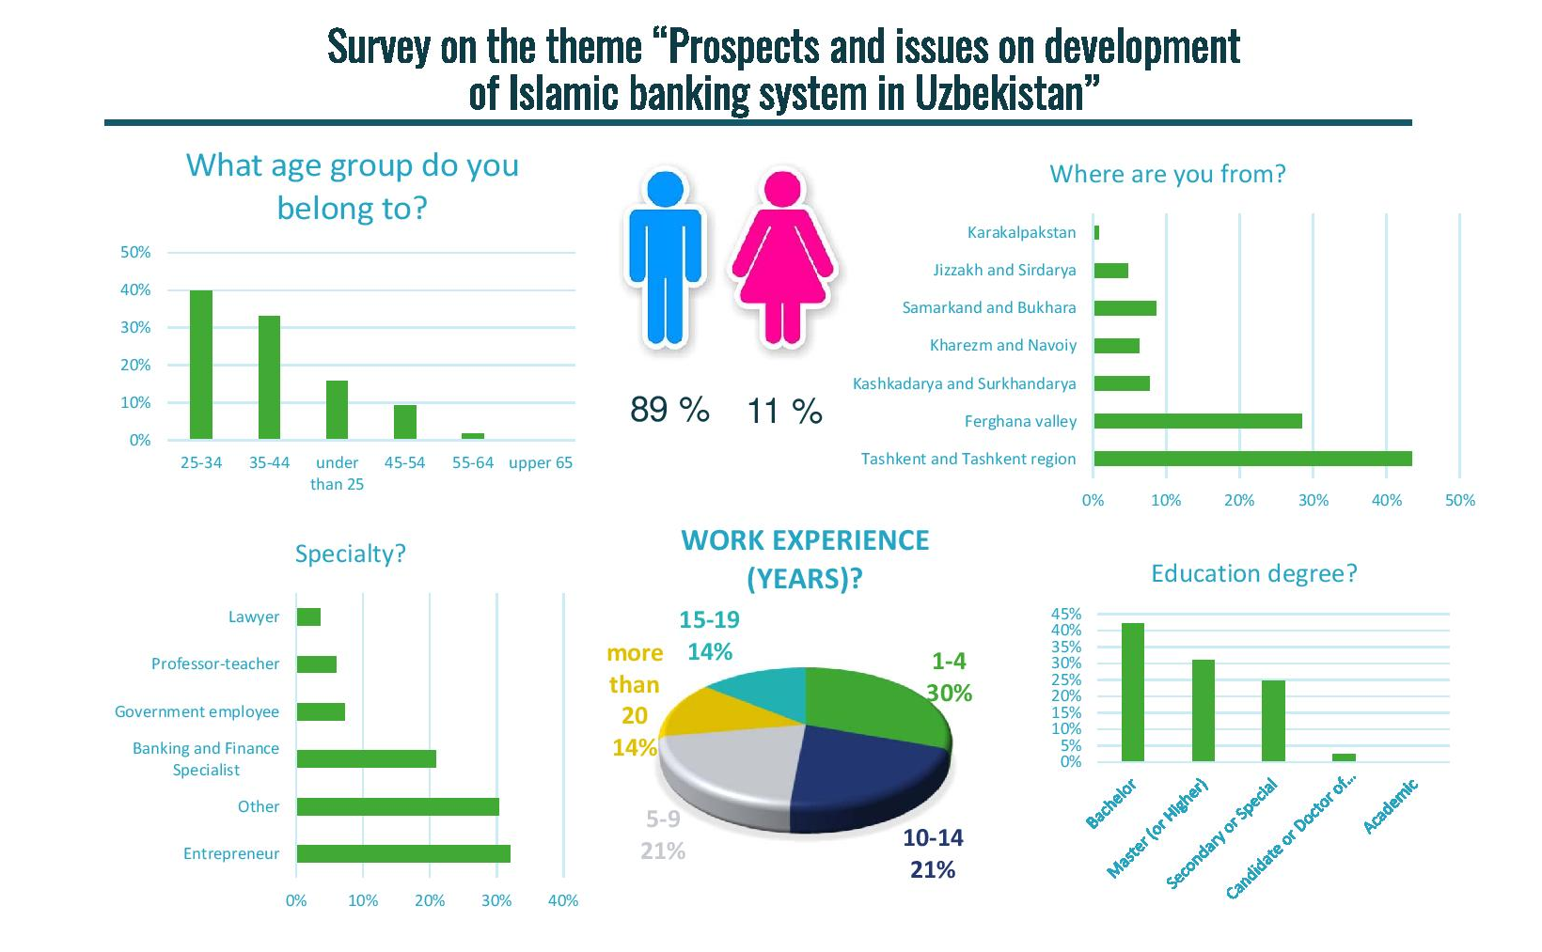
Survey on the theme “Prospects and issues on the development of Islamic Finance in Uzbekistan”

Slide 12
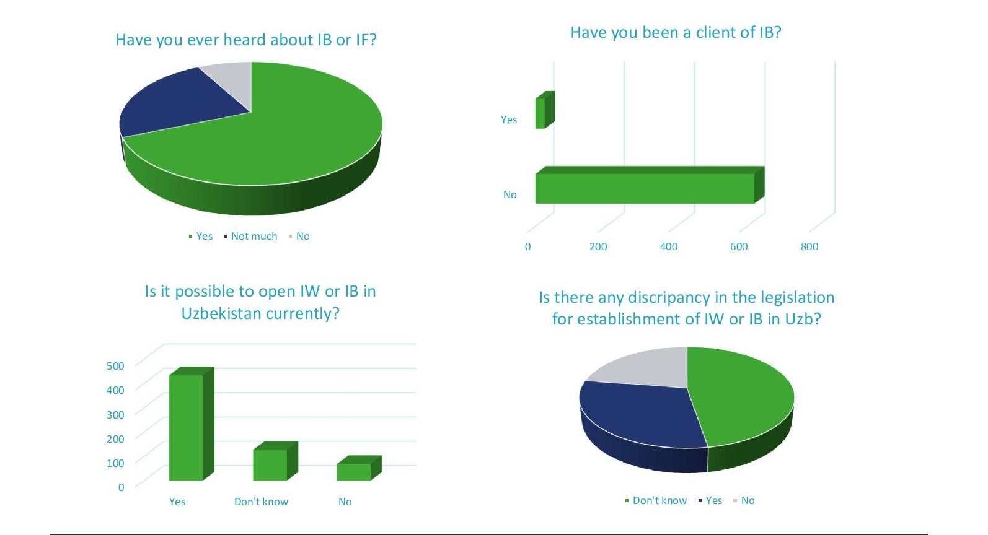
Survey on the theme “Prospects and issues on the development of Islamic Finance in Uzbekistan”

Slide 13
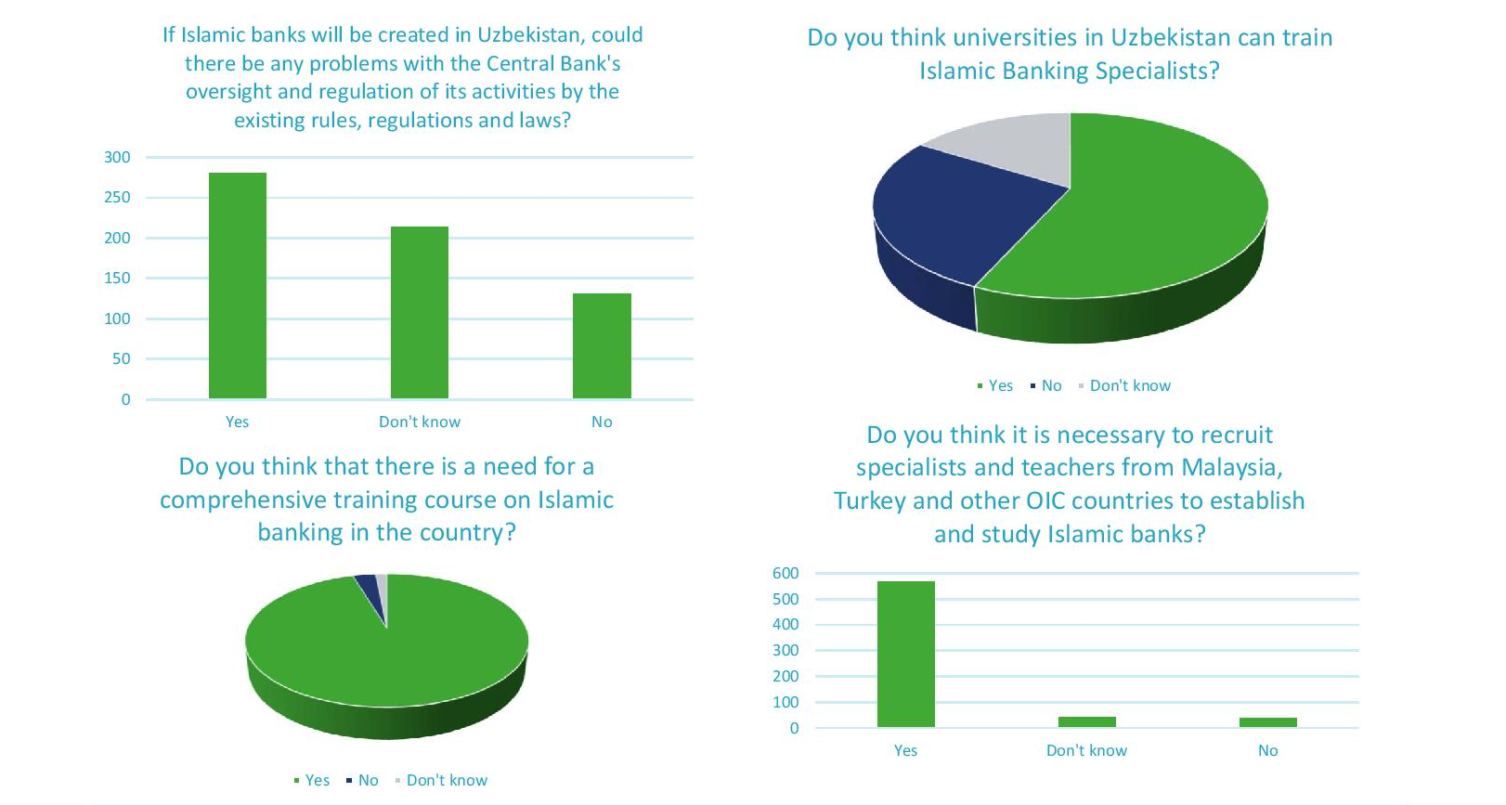
Survey on the theme “Prospects and issues on the development of Islamic Finance in Uzbekistan”

Slide 14
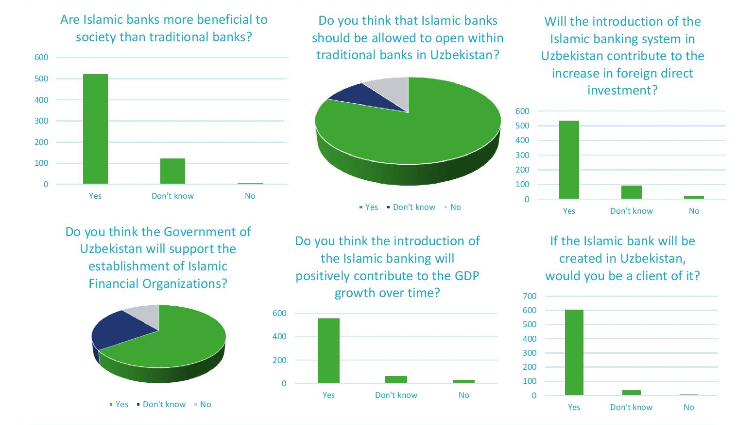
Survey on the theme “Prospects and issues on the development of Islamic Finance in Uzbekistan”

Slide 15
Islamic Financial Products which can be offer under existing Legislation in Uzbekistan
Ijarah
Takaful
Istisna
Salam
Qard
Murabah

Slide 16
Thank You

